Slide 1
Data classification
13.10.2023
Illimar Rekand (he/him)
Data steward
University of Bergen
ELIXIR Norway
Some slides adapted from Nazeefa Fatima, 2022 under CC-BY 4.0
Notes:
https://tinyurl.com/SensDataQuest

Slide 2
Disclaimer
This is not legal advice

Slide 3

Open Data
“As open as possible - as closed as necessary”

Slide 4

Sensitive data:
“Sensitive data is data that must be protected against unwanted disclosure.
Access to sensitive data should be safeguarded. Protection of sensitive data may be required for legal or ethical reasons, for issues pertaining to personal privacy, or for proprietary consideration”
https://www.openaire.eu/sensitive-data-guide
Notes:
Poll https://forms.gle/5a8vr9noRF9e6Cbv7

Slide 5

What is personal data? Examples:
Further reading: https://ec.europa.eu/info/law/law-topic/data-protection/reform/what-personal-data_en
Notes:
1

Slide 6

The following personal data is considered ‘sensitive’ and is subject to specific processing conditions:
personal data revealing racial or ethnic origin, political opinions, religious or philosophical beliefs;
trade-union membership;
genetic data, biometric data processed solely to identify a human being;
health-related data;
data concerning a person’s sex life or sexual orientation.
https://commission.europa.eu/law/law-topic/data-protection/reform/rules-business-and-organisations/legal-grounds-processing-data/sensitive-data/what-personal-data-considered-sensitive_en

Slide 7


What defines genetic data?
Genetic data is defined as: “personal data relating to the inherited or acquired genetic characteristics of a natural person which give unique information about the physiology or the health of that natural person.” - GDPR article 4(13)
Always both: Personal identifier and sensitive information!
Further reading - what personal data is considered sensitive?: https://ec.europa.eu/info/law/law-topic/data-protection/reform/rules-business-and-organisations/legal-grounds-processing-data/sensitive-data/what-personal-data-considered-sensitive_en
Notes:
1

Slide 8
Take-home message 1:
If you are dealing with data that comes from/relates to people in one form or another….
… you are probably dealing with sensitive data

Slide 9

Important Relevant Legislations
Personal Data Act
Regulations on the processing of personal data
General Data Protection Regulation (GDPR)
The GDPR is an EU Regulation that applies
directly to Norway, as a member of the EEA.

Slide 10


GDPR: General Data Protection Regulation
Protection of Personal Data
Privacy by Design
Data Protection Impact Assessment (DPIA)
Processing of Personal Data
Technical and organisational measure to secure data
Records of Processing Activities
Access rights, Right to be forgotten, Right on Information
€
Fines: Up to 20 million Euros (<4 % of total global turnover
preceding fiscal year)
GDPR: https://eur-lex.europa.eu/legal-content/EN/TXT/PDF/?uri=OJ:L:2016:119:FULL

Slide 11
What does GDPR say about:
Data subjects, processing, controller, and processors
Data subject:
“the natural person information relates to.”- GDPR article 4(1)
Data Processing:
“any operation or set of operations which is performed on personal data or on sets of personal data.” - GDPR article 4(2)
Data Controller: determines the purposes and means of the processing of personal data
Data Processor: processes personal data on behalf of the controller
Further reading: https://eur-lex.europa.eu/legal-content/EN/TXT/HTML/?uri=CELEX:32016R0679&from=EN#d1e1489-1-1
Notes:
1

Slide 12
Conditions to store/process personal (sensitive) data
Lawful and transparent manner (‘lawfulness, fairness and transparency’)
Specific purposes (‘purpose limitation’)
Only the personal data that is necessary to fulfil that purpose (‘data minimisation’)
Stored for no longer than necessary (‘storage limitation’)
Data Accuracy
Technical and organisational safeguards that ensure the security of the personal data, including protection against unauthorised or unlawful processing and against accidental loss, destruction or damage, using appropriate technology (‘integrity and confidentiality’)
Accountability → Immediate reporting of incidents
Further reading: https://eur-lex.europa.eu/legal-content/EN/TXT/HTML/?uri=CELEX:32016R0679&from=EN#d1e1807-1-1
Notes:
1

Slide 13


Criteria to store/process personal (sensitive) data
Explicit consent from participant
Health Research Act
The data is processed for archiving, scientific or historical research purposes or statistical purposes on the basis of EU or national law.
“Tasks carried out in the public interest” - Article 6, GDPR
“It is not always possible to fully identify the purpose of personal data processing for scientific research purposes at the time of data collection” - GDPR, Recital 33
Further readings:
https://ec.europa.eu/info/law/law-topic/data-protection/reform/rules-business-and-organisations/legal-grounds-processing-data/sensitive-data/under-what-conditions-can-my-company-organisation-process-sensitive-data_en
https://lovdata.no/dokument/NL/lov/2008-06-20-44/KAPITTEL_4#KAPITTEL_4
Notes:
1

Slide 14
Criteria to store/process personal (sensitive) data
Explicit consent from participant
Health Research Act
If you are using consent as your legal basis:
Make sure your consent form (& REK* approval)
allows controlled access deposition (e.g. to EGA**)
...before you start!
* REK: Regional Committees for Medical and Health Research Ethics
** EGA: European Genome Archive
Further readings:
https://ec.europa.eu/info/law/law-topic/data-protection/reform/rules-business-and-organisations/legal-grounds-processing-data/sensitive-data/under-what-conditions-can-my-company-organisation-process-sensitive-data_en
https://lovdata.no/dokument/NL/lov/2008-06-20-44/KAPITTEL_4#KAPITTEL_4
Notes:
1

Slide 15


Important Relevant Legislations
Research Ethics Act
Health Research Act
Health Registry Act
Biotechnology Act
Archive Act
Patents Act
Copyrights Act
●
Health Register Act: https://lovdata.no/dokument/NL/lov/2014-06-20-43
●
Biotechnology Act: https://lovdata.no/dokument/NL/lov/2003-12-05-100
●
Archives Act: https://lovdata.no/dokument/NL/lov/1992-12-04-126
●
Patents Act: https://lovdata.no/dokument/LTI/lov/2019-06-21-49
●
Copyright Act: https://lovdata.no/dokument/NL/lov/2018-06-15-40

Slide 16

Personal Data Act & Personal Data Regulations
National Implementation of GDPR
Consent from participants (13 years and older)
Exceptions for archival, public interest, and scientific reasons
Authorities: Privacy Ombudsman, Privacy Committees,
Data Inspectorates (datatilsynet)
More information at:
Regulations on the processing of personal data: https://lovdata.no/dokument/SF/forskrift/2018-06-15-876
Transitional rules on the processing of personal data: https://lovdata.no/dokument/SF/forskrift/2018-06-15-877
Personal Data Act: https://lovdata.no/dokument/NL/lov/2018-06-15-38
Notes:
1

Slide 17

Research Ethics Act
Withhold-, mislead about-, or selectively/secretly dispose of undesired results
Improper allocation of authorship etc.
Concealment of scientific efforts and / or scientific achievements.
Destruction of research data / material to prevent investigations of misconduct
Research Ethics Act: https://lovdata.no/dokument/NL/lov/2017-04-28-23

Slide 18


Health Research Act
Prior approval for health research
Consent from participants
Data access rights for participants
Biobank Regulations
Maximum data storage time for non-archived data
(Default: 5 years after end of project – exemptions: approval)
Regional Committees for Medical and Health Research Ethics (REK)
Health Research Act: https://lovdata.no/dokument/LTI/lov/2008-06-20-44
https://rekportalen.no/#omrek/REK

Slide 19
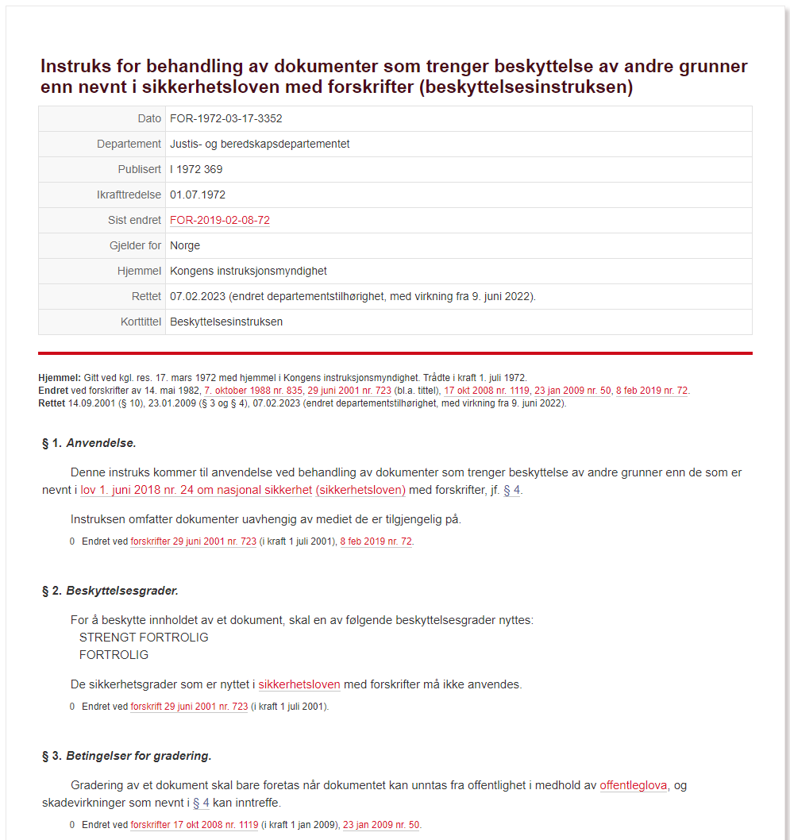
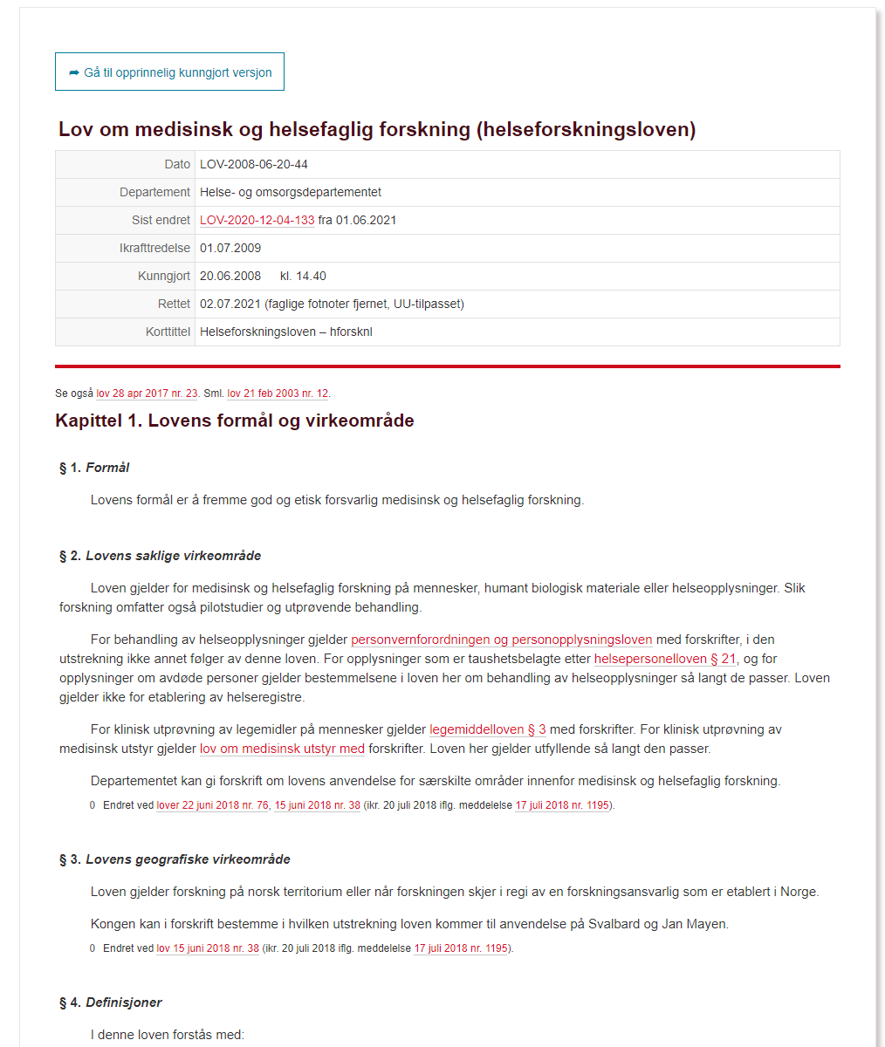

Norwegian law dictates how graded information needs to be handled
Norwegian law dictates how medical research can be conducted
https://lovdata.no/dokument/INS/forskrift/1972-03-17-3352

Slide 20
Fairness and Transparency
➔ Fairness: Not taking advantage of your position as a research institution, and not taking advantage of your position in relation to the data subjects
➔ Transparency: Your data subjects shall be informed of what you do with their personal data, and and of how to exercise their rights
➔ Provision of the required information in a clear and plain language
Further reading:
https://ec.europa.eu/info/law/law-topic/data-protection/reform/rules-business-and-organisations/legal-grounds-processing-
data/sensitive-data/under-what-conditions-can-my-company-organisation-process-sensitive-data_en
https://eur-lex.europa.eu/legal-content/EN/TXT/HTML/?uri=CELEX:32016R0679&from=EN#d1e1888-1-1
https://lovdata.no/dokument/NL/lov/2008-06-20-44/KAPITTEL_8#KAPITTEL_8

Slide 21
Data Minimisation
➔ The amount of personal data shall be limited to that necessary to achieve the purpose of data processing
➔ Obligation to avoid collecting, storing or in any other way processing personal data that is not strictly necessary, even if it may be “nice to have”
Further reading:
https://ec.europa.eu/info/law/law-topic/data-protection/reform/rules-business-and-organisations/legal-grounds-processing-
data/sensitive-data/under-what-conditions-can-my-company-organisation-process-sensitive-data_en
https://eur-lex.europa.eu/legal-content/EN/TXT/HTML/?uri=CELEX:32016R0679&from=EN#d1e1888-1-1
https://lovdata.no/dokument/NL/lov/2008-06-20-44/KAPITTEL_8#KAPITTEL_8

Slide 22
Data Accuracy
➔ Important not only in consideration of the data subjects but also for your research
➔ Obligation to rectify or delete inaccurate personal data
➔ Your data subject can ask for deletion of the data at any time
Further reading:
https://ec.europa.eu/info/law/law-topic/data-protection/reform/rules-business-and-organisations/legal-grounds-processing-
data/sensitive-data/under-what-conditions-can-my-company-organisation-process-sensitive-data_en
https://eur-lex.europa.eu/legal-content/EN/TXT/HTML/?uri=CELEX:32016R0679&from=EN#d1e1888-1-1
https://lovdata.no/dokument/NL/lov/2008-06-20-44/KAPITTEL_8#KAPITTEL_8

Slide 23
Storage Limitation
➔
Personal data shall not be stored for longer than necessary to fulfil the purpose
➔
Once the purpose has been achieved, the data shall in principle be deleted or made anonymous
➔
REK usually sets requirements for storage beyond the project period for reasons of verifiability - you may need to include this in your application!
➔
Processing personal data for the purpose of verifiability is legitimate
➔
Personal data may be stored for longer periods so far as the personal data is processed solely for scientific, historical, and/or statistical research
Further reading:
https://ec.europa.eu/info/law/law-topic/data-protection/reform/rules-business-and-organisations/legal-grounds-processing-
data/sensitive-data/under-what-conditions-can-my-company-organisation-process-sensitive-data_en
https://eur-lex.europa.eu/legal-content/EN/TXT/HTML/?uri=CELEX:32016R0679&from=EN#d1e1888-1-1
https://lovdata.no/dokument/NL/lov/2008-06-20-44/KAPITTEL_8#KAPITTEL_8

Slide 24





Responsible Authorities

Slide 25

Data Privacy Assessments
Since 2020:
Sikt carries out privacy assessments on behalf of Norwegian universities. Processing personal data in project → Apply to Sikt
Minimum 30 days before data collection starts
https://sikt.no/en/notification-form-personal-data

Slide 26

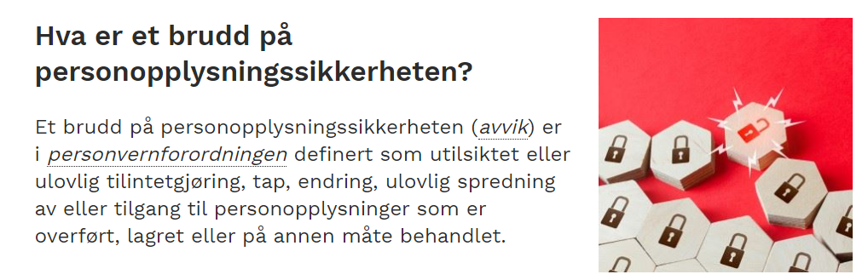
What constitutes a breach of personal data protection?
Breach in (either intentionally or
unintentionally):
Confidentiality
Information has been leaked
Integrity
Information has been changed
Availability
Access/Denial, access/deletion
If suspected breach:
Duty to report!
How and where to report?
https://www.datatilsynet.no/rettigheter-og-plikter/virksomhetenes-plikter/avvik/meld-avvik-til-datatilsynet/
https://www.datatilsynet.no/rettigheter-og-plikter/virksomhetenes-plikter/avvik/hva-er-et-brudd-pa-personopplysningssikkerheten/#:~:text=Et%20brudd%20p%C3%A5%20personopplysningssikkerheten%20(avvik,eller%20p%C3%A5%20annen%20m%C3%A5te%20behandlet
Notes:
Brudd på konfidensialitet, det vil si at det har vært en utilsiktet eller ulovlig utlevering av, eller tilgang til, personopplysninger.
Brudd på integritet, det vil si at det har vært en utilsiktet eller ulovlig endring av personopplysninger.
Brudd på tilgjengelighet, det vil si der det har vært et utilsiktet eller ulovlig tap av tilgang til, eller sletting av, personopplysninger.

Slide 27

REK
Health research based on personal data needs approval from Regional Etisk Komité (REK) before the research project starts
Inquiries are sent to the relevant region
Deadlines throughout the year
https://rekportalen.no/#omrek/REK

Slide 28
Other reasons data can be considered sensitive:
Intellectual property rights (IPR):
Patentability, trade secrets, investigations
Strategy documents
Biological data: Endangered species (location data)

Slide 29
Subsets of data classification

Slide 30
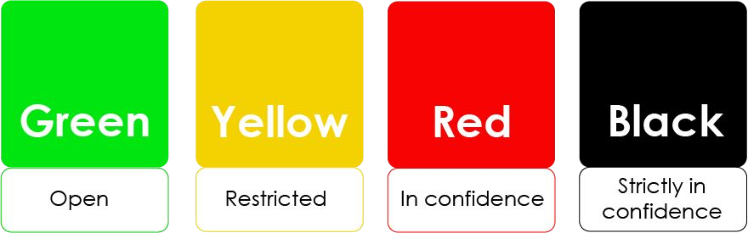
Integrity and Confidentiality
➔
Personal data must be processed in a manner that ensures:
appropriate security of the personal data,
protect personal data against unauthorized access,
unlawful processing,
accidental loss, distribution, amendment or damage
Follow institutional guidelines
➔
Pseudonymisation
◆
Dedicated data analysis platforms
Image Source: https://uio.no/english/for-employees/support/research/funding/units/hf/imv/data-ethics/colors.htm
More about TSD: https://www.uio.no/english/services/it/research/sensitive-data/

Slide 31
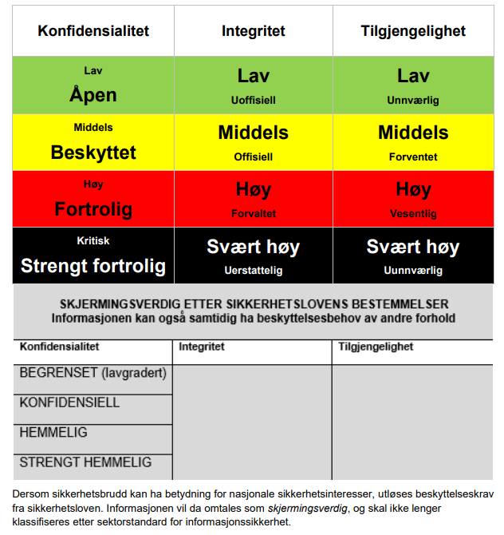
Sikt –
Norwegian Agency for Shared Services in Education and Research
General guidelines for data classification
Archives sensitive data of “people and society” with different levels of access
https://sikt.no/en/archiving-research-data
https://cms.sikt.no/sites/default/files/2023-02/Veileder_verdioversikt.pdf

Slide 32
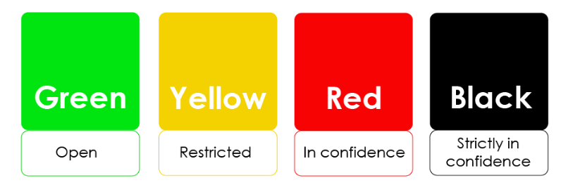

University of Oslo - guidelines for data classification
many types of personal data
special category (personal sensitive) data
large amounts of special category data
https://www.uib.no/lagring; https://www.uio.no/english/services/it/security/lsis/data-classes.html

Slide 33
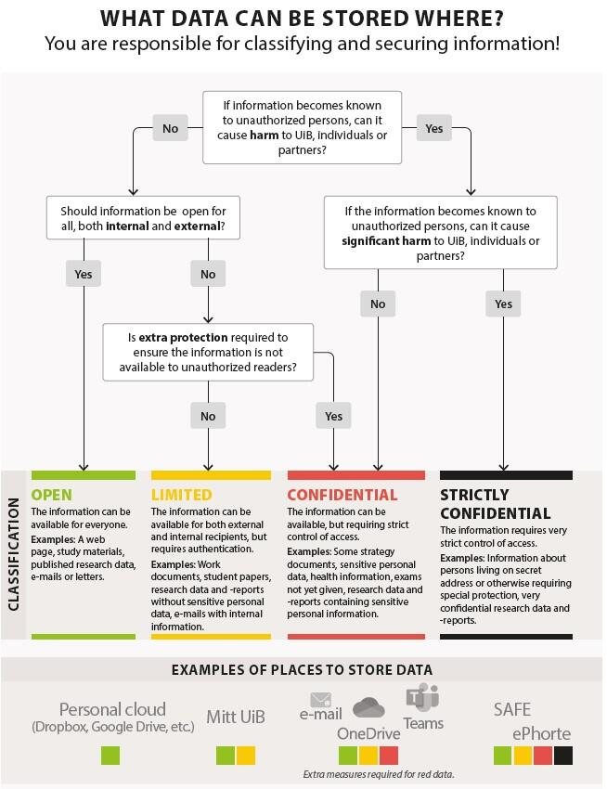

University of Bergen guidelines for data classification
SAFE is the recommended solution for handling sensitive data
https://www.uib.no/en/foremployees/153608/storage-guide#physical-storage-media-nbsp-

Slide 34
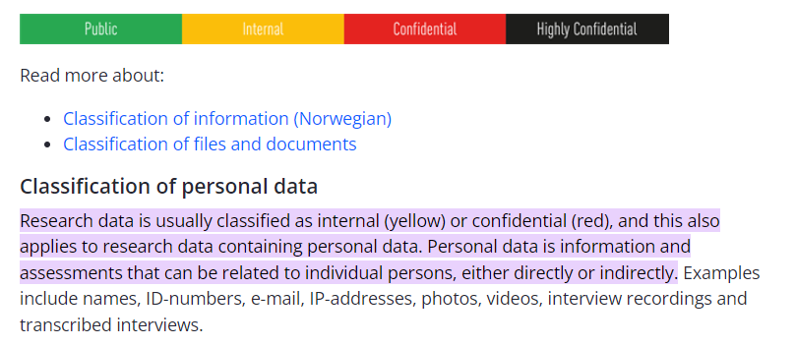
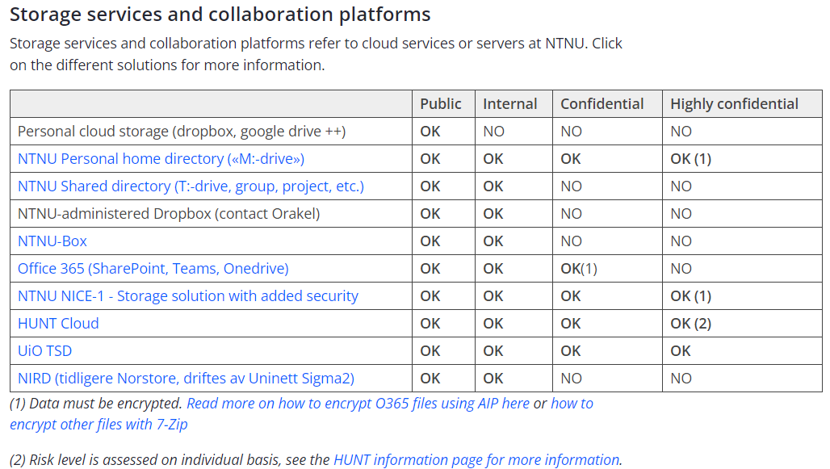

NTNU - guidelines for data classification
https://i.ntnu.no/wiki/-/wiki/English/Data+storage+guide#:~:text=Research%20data%20is%20usually%20classified,persons%2C%20either%20directly%20or%20indirectly.

Slide 35
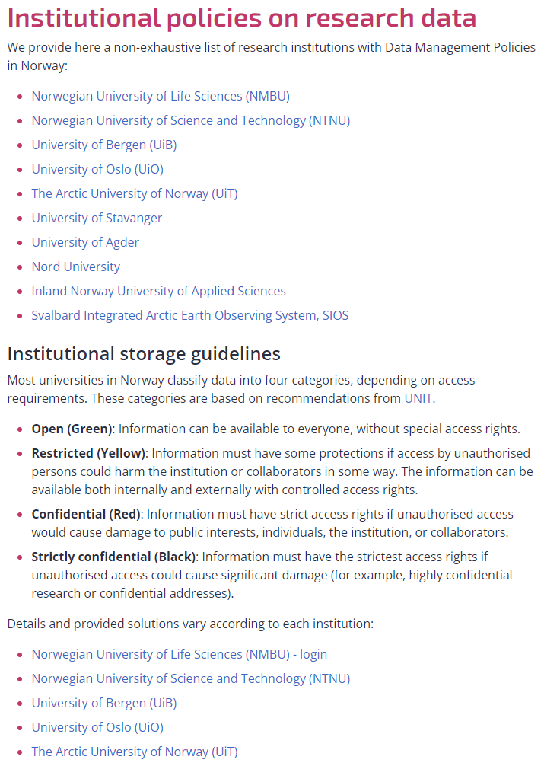

RDMkit has an overview of the different institutional guidelines
RDM resources/policies in Norway https://rdmkit.elixir-europe.org/no_resources#institutional-policies-on-research-data

Slide 36
Does my data need require protection?
Data
Is the data from people?
Probably needs
special protection
No
Yes
Yes
personal data revealing racial or ethnic origin, political opinions, religious or philosophical beliefs;
trade-union membership;
genetic data, biometric data processed
solely to identify a human being;
health-related data;
data concerning a person’s sex life or sexual orientation
Do you wish to use the data as a basis for a patent?
No
If sensitive; how should it be classified?
Does the data fall under the European Commision definition of personal data?
https://commission.europa.eu/law/law-topic/data-protection/reform/rules-business-and-organisations/legal-grounds-processing-data/sensitive-data/what-personal-data-considered-sensitive_en
Would it be harmful for you, the institution you are working for or anyone else if the data was available for anyone else?
No
Probably no special protection
Yes
No
Not sensitive
Yes
Does it fall under special category data?
Yes
No
Probably needs
special protection
Probably does not
need special protection
Probably needs
special protection
Probably does not needs
special protection

Slide 37
Take-home message 2:
Familiarize yourself with how your institution deals with data classification

Slide 38
How to deal with sensitive data:
special attention should be given to collecting, processing, handling and storing data throughout the research process
Address in a DMP how the above will be dealt with
https://www.openaire.eu/sensitive-data-guide

Slide 39

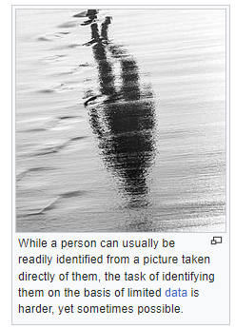
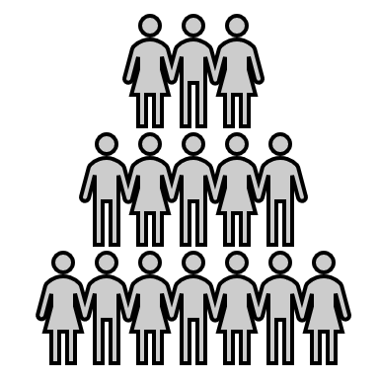

Data Pseudonymisation
Original dataset
Pseudonymized dataset
© Tomas Castelazo,
tomascastelazo.com / Wikimedia Commons / CC BY-SA 4.0

Slide 40
Data Pseudonymisation
“The processing of personal data in such a manner that the personal data
can no longer be attributed to a specific data subject without the use of
additional information, provided that such additional information is kept
separately and is subject to technical and organisational measures to
ensure that the personal data are not attributed to an identified or
identifiable natural person” - GDPR article 4(13)
➔ De-identified and not back traceable for the researcher without the identifier
‼
Pseudonymised data is still personal data!

Slide 41
Anonymous Data
➔ Anonymous data cannot in any way be used to identify individuals in
a data material, either:
◆ directly by name or personal identification number or
◆ indirectly by additional information
! Not possible for many data types, such as genetic data !

Slide 42
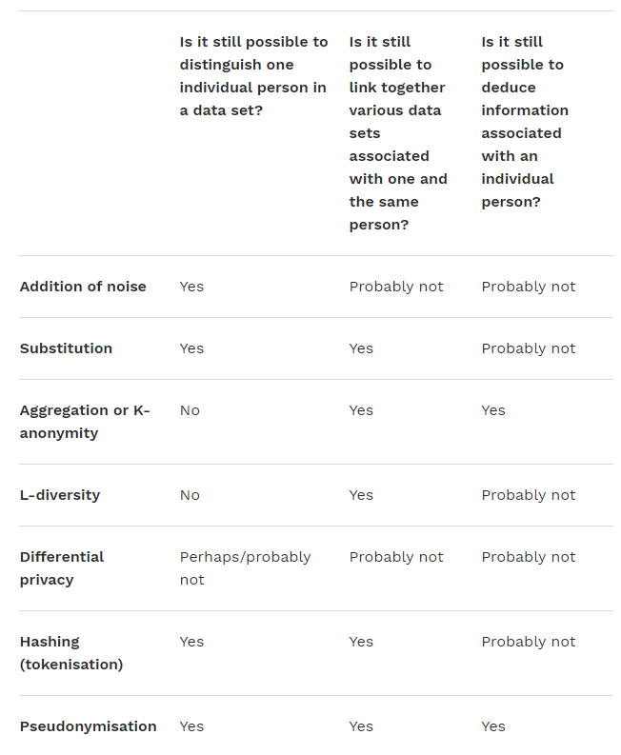
The Norwegian Data Protection Agency (Datatilsynet) has created some recommendations for secure anonymization
“At an early stage, the data controller must decide whether the personal data to be processed should be anonymised, de-identified or left identifiable.”
https://www.datatilsynet.no/en/regulations-and-tools/reports-on-specific-subjects/anonymisation/recommondations-for-secure-anonymisation/

Slide 43
Take-home message 3:
Data pseudonymization (aka. deidentification)
≠
Anonymization

Slide 44

International Data Transfers
EC has recognized:
Andorra, Argentina,
Canada, Faroe Islands,
Guernsey, Israel, Isle of
Man, Japan, Jersey,
New Zealand, Switzerland, Uruguay, and the UK
Key relevance in scientific research
Countries outside the EU/EEA (“Third countries”)
Transfer mechanism pursuant to GDPR chapter 5
Adequacy Decision
Most common: Standard Contractual Clauses (SCCs) adopted by
the European Commission (EC)
Additional safeguards - e.g. Pseudonymization
Exchange of personal data & biological material (for research) in any direction requires special and careful additional consideration!
Further reading:
eur-lex.europa.eu/legal-content/EN/TXT/HTML/?uri=CELEX:32016R0679&from=EN#d1e4319-1-1
ec.europa.eu/info/law/law-topic/data-protection/reform/rules-business-and-organisations/obligations/what-rules-apply-if-my-organisation-transfers-data-outside-eu_en
gov.uk/government/news/eu-adopts-adequacy-decisions-allowing-data-to-continue-flowing-freely-to-the-uk
Notes:
1

Slide 45
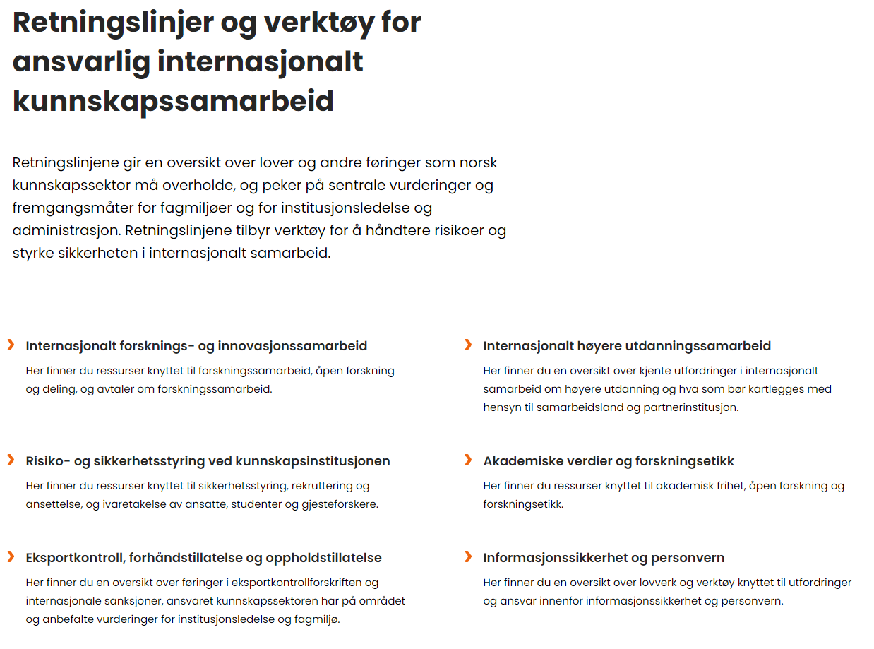
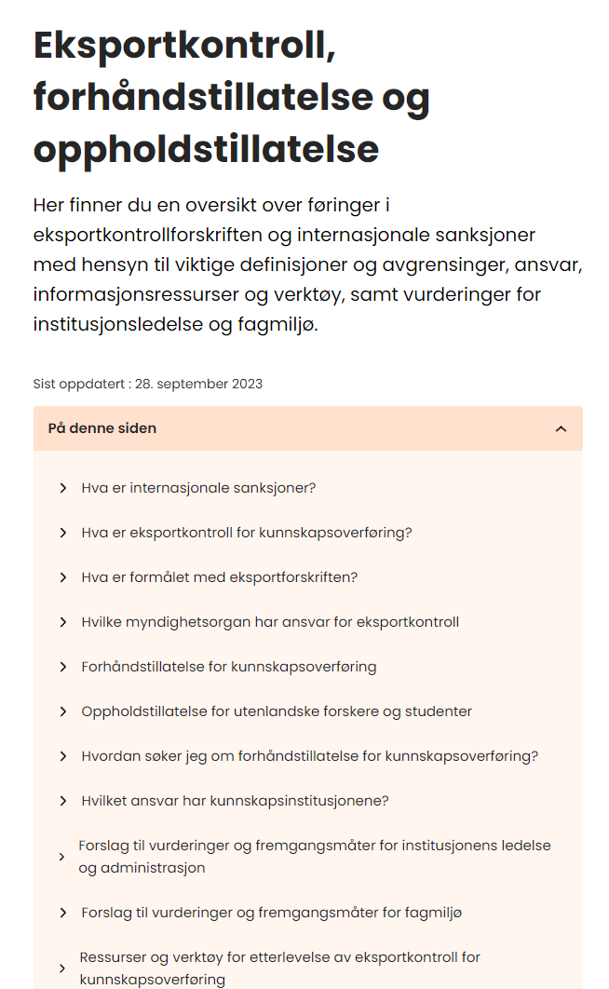

Guidelines for sharing data across borders
https://hkdir.no/retningslinjer-og-verktoy-for-ansvarlig-internasjonalt-kunnskapssamarbeid

Slide 46


https://www.openaire.eu/
Notes:
The European Commission launched OpenAIRE in 2010 as both an online portal (infrastructure) and a network of helpdesks and experts (34 National Open Access Desk (NOADs). Its original objective was to support the implementation of the European open access policies: the ERC Scientific Council Guidelines for Open Access (2007) and the Open Access (OA) pilot in FP7

Slide 47
Questions?
support@elixir.no
Email: Illimar.rekand@uib.no
Twitter/X: @illimar

Slide 48


Thank you!
elixir-norway.org
@elixirnorway
support@elixir.no
Except where otherwise noted, this work is licensed under a
Creative Commons Attribution 4.0 International License
https://creativecommons.org/licenses/by/4.0/
Notes:
1

Slide 49

Data Classification © 2023 by Elixir Norway is licensed under CC BY-SA 4.0. To view a copy of this license, visit http://creativecommons.org/licenses/by-sa/4.0/

